Slide 1
Introduction to ML and Support Vector Machines
- Vikas Thammanna Gowda

Slide 2
Agenda
What is ML? Why ML?
Categories of ML
Support Vector Machines
Basic idea
Special Cases
History and Development
Math

Slide 3
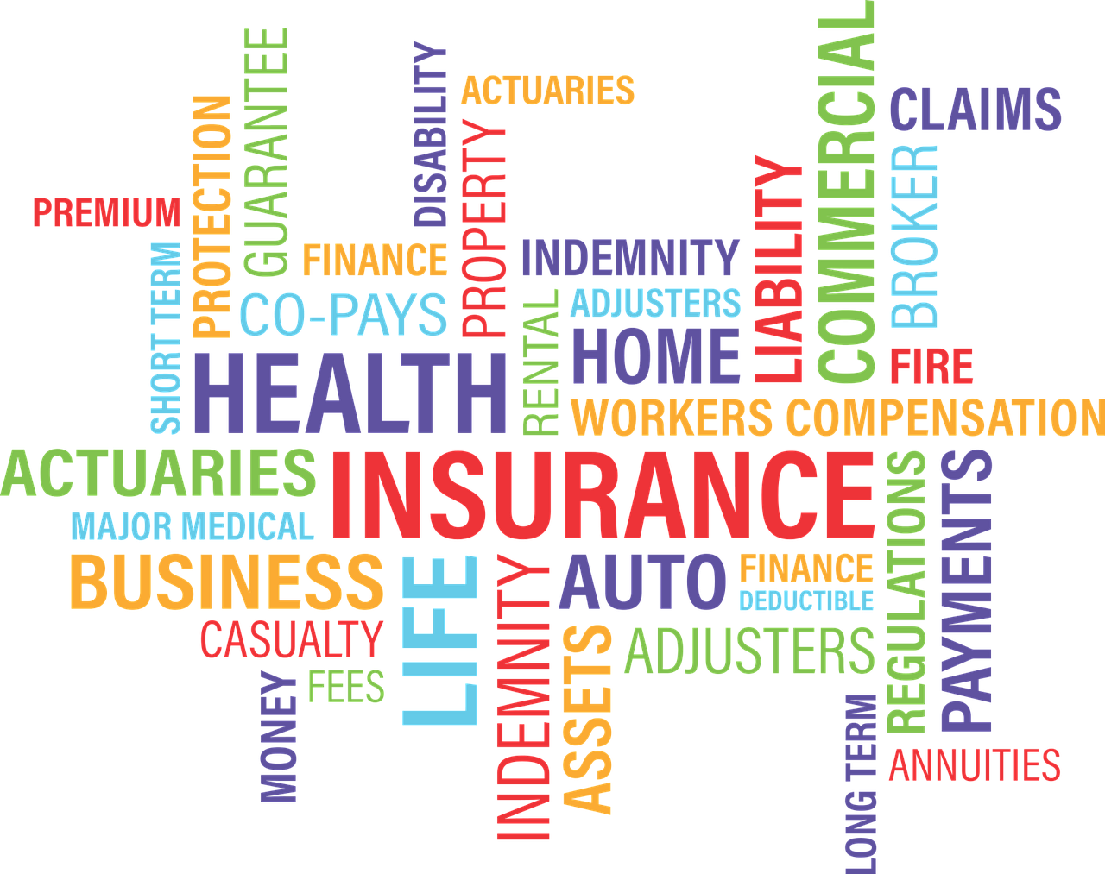

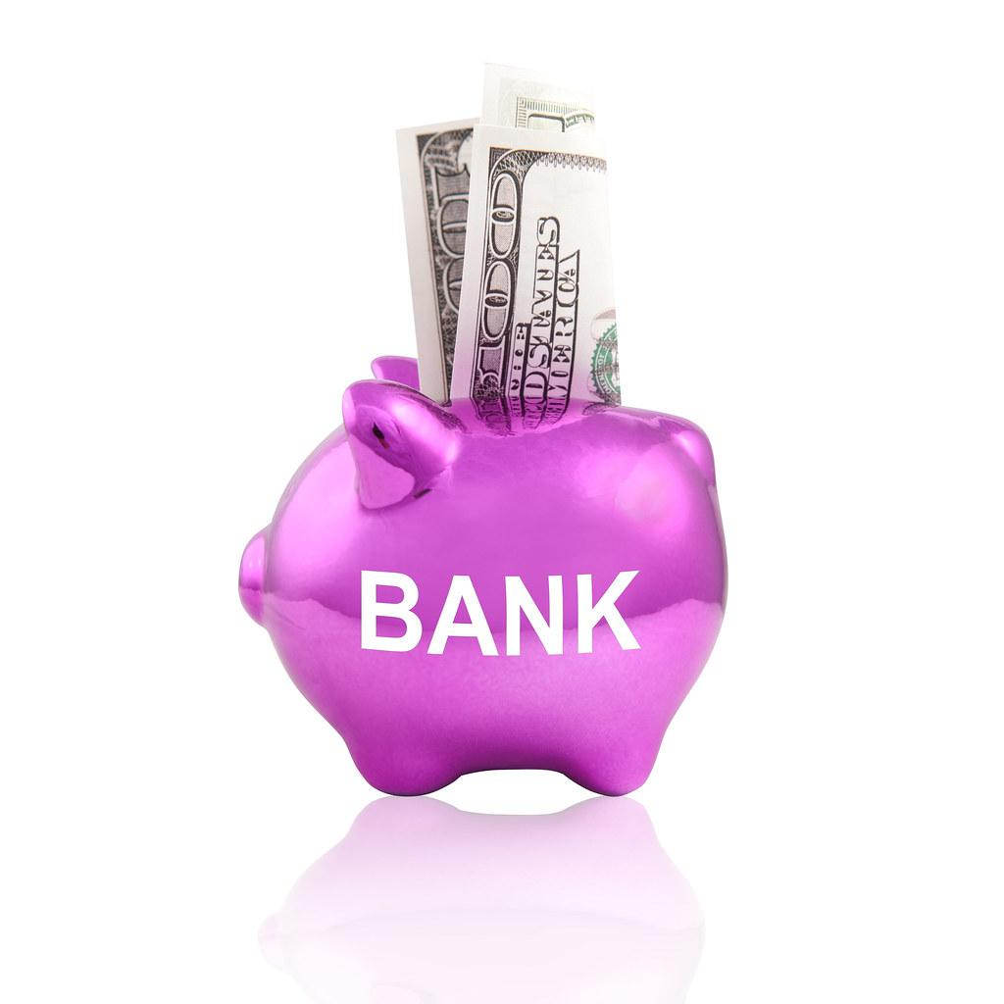

What is Machine Learning?
Arthur Samuel: Machine Learning is the field of study that gives computers the ability to learn without being explicitly programmed.
ML is a collection of algorithms and techniques used to create computational systems that learn from data in order to make predictions and inferences.

Slide 4

Why Machine Learning?
4U
credit card
free
amazing
if
else
The traditional approach

Slide 5
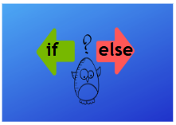
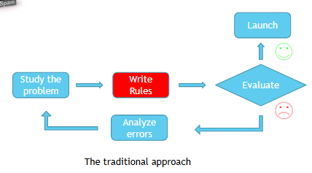
Why Machine Learning?
4U
credit card
free
amazing
The traditional approach

Slide 6
Why Machine Learning?
For U
credit card
free
amazing
The traditional approach

Slide 7
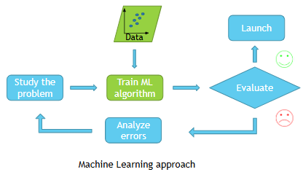
Why Machine Learning?
For U
credit card
free
amazing
The traditional approach

Slide 8
Agenda
What is ML? Why ML?
Categories of ML
Support Vector Machines
Basic idea
Special Cases
History and Development
Math

Slide 9
Categories of Machine Learning
Machine Learning
Supervised
Learning
Unsupervised
Learning
Reinforcement Learning
Dynamic
Programming
Robot
Navigation
Regression
Clustering
Association Analysis
Classification
Gaming

Slide 10
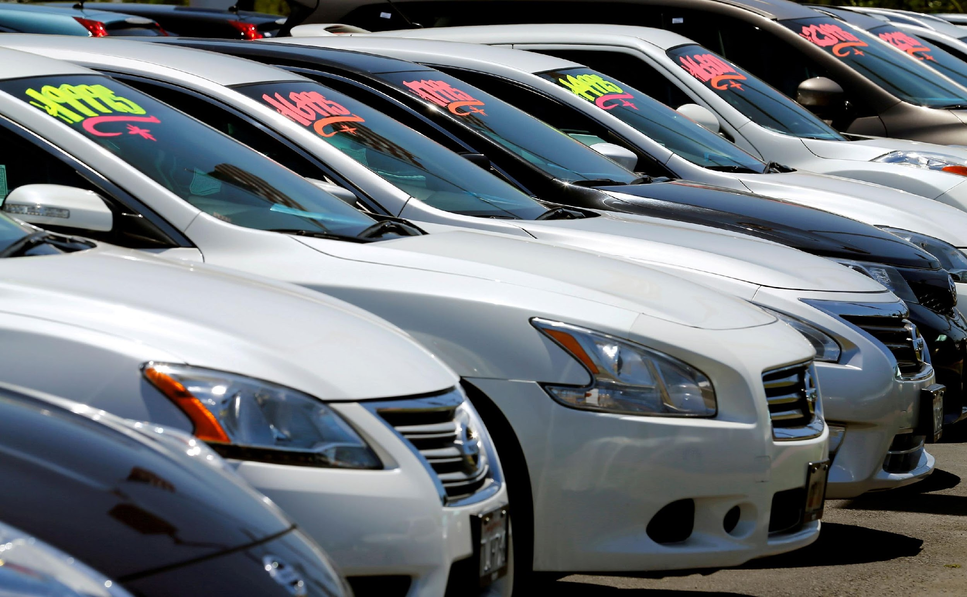


Categories of Machine Learning
Machine Learning
Supervised
Learning
Unsupervised
Learning
Reinforcement Learning
Dynamic
Programming
Robot
Navigation
Regression
Clustering
Association Analysis
Classification
Gaming

Slide 11
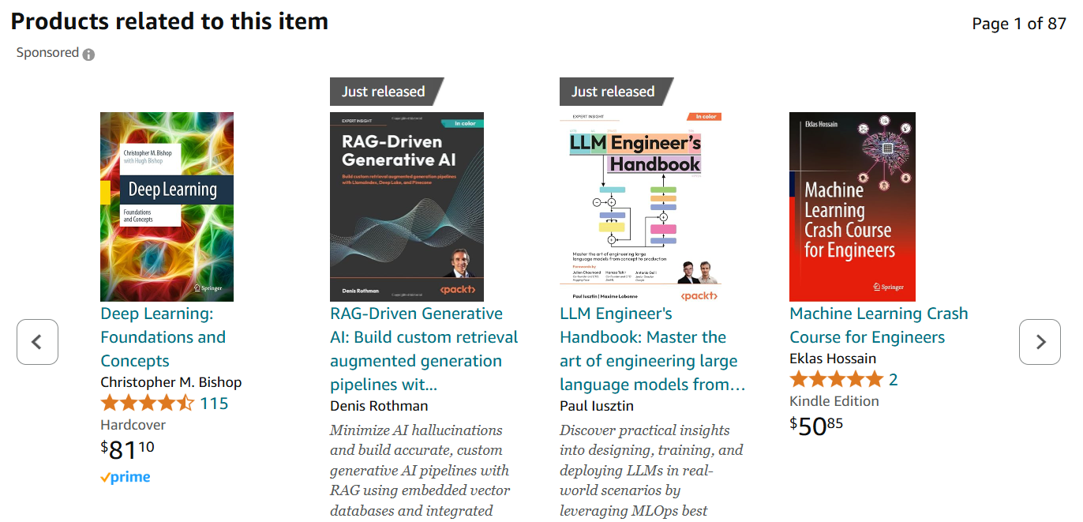
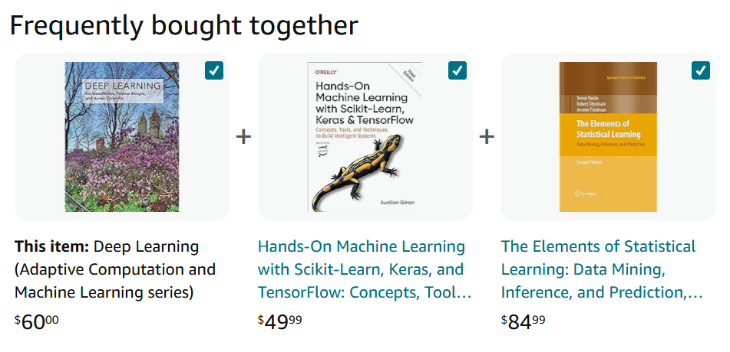
Categories of Machine Learning
Machine Learning
Supervised
Learning
Unsupervised
Learning
Reinforcement Learning
Dynamic
Programming
Robot
Navigation
Regression
Clustering
Association Analysis
Classification
Gaming

Slide 12
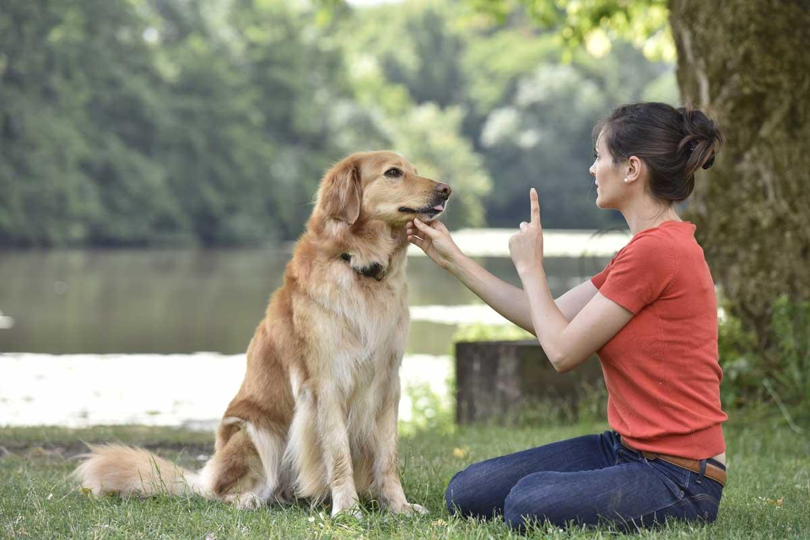
Categories of Machine Learning
Machine Learning
Supervised
Learning
Unsupervised
Learning
Reinforcement Learning
Dynamic
Programming
Robot
Navigation
Regression
Clustering
Association Analysis
Classification
Gaming

Slide 13
Agenda
What is ML? Why ML?
Categories of ML
Support Vector Machines
Basic idea
Special Cases
History and Development
Math

Slide 14
Support Vector Machines
The basic idea
SAT
GPA

Slide 15
Support Vector Machines
The basic idea
SAT
+1
-1
GPA

Slide 16
Support Vector Machines
The basic idea
SAT
+1
Can we find a straight line that separates the two classes?
-1
GPA

Slide 17
Support Vector Machines
The basic idea
SAT
+1
Can we find a straight line that separates the two classes?
-1
GPA

Slide 18
Support Vector Machines
The basic idea
SAT
+1
Can we find a straight line that separates the two classes?
-1
GPA

Slide 19
Support Vector Machines
The basic idea
SAT
+1
Can we find a straight line that separates the two classes?
-1
GPA

Slide 20
Support Vector Machines
The basic idea
SAT
+1
-1
GPA

Slide 21
Support Vector Machines
The basic idea
Margins
SAT
+1
Support Vectors
-1
Decision Boundary
GPA

Slide 22
Support Vector Machines
The basic idea
Margins
SAT
+1
Support Vectors
-1
Maximum Margin Classifiers
Decision Boundary
GPA
Maximize Margin

Slide 23
Agenda
What is ML? Why ML?
Categories of ML
Support Vector Machines
Basic idea
Special Cases
History and Development
Math

Slide 24
Support Vector Machines
Case 1: Linearly Separable Data
Margins
SAT
+1
Support Vectors
-1
Decision Boundary
Hard Margin
SVM
GPA

Slide 25
Support Vector Machines
Case 2a: Linearly Inseparable

Slide 26
Support Vector Machines
Case 2a: Linearly Inseparable

Slide 27
Support Vector Machines
Case 2a: Linearly Inseparable

Slide 28
Support Vector Machines
Case 2a: Linearly Inseparable
Kernel
Trick

Slide 29
Support Vector Machines
Case 2a: Linearly Inseparable
Instead of explicitly transforming data (expensive!), we use a kernel function that computes similarity in the higher dimension WITHOUT actually going there.
Kernel
Trick

Slide 30
Support Vector Machines
Case 2b: Linearly Inseparable
SAT
+1
-1
GPA

Slide 31
Support Vector Machines
Case 2b: Linearly Inseparable
SAT
SAT
+1
+1
-1
-1
GPA
GPA

Slide 32
Support Vector Machines
Case 2b: Linearly Inseparable
SAT
SAT
+1
+1
-1
-1
Soft Margin
SVM
GPA
GPA

Slide 33
Agenda
What is ML? Why ML?
Categories of ML
Support Vector Machines
Basic idea
Special Cases
History and Development
Math

Slide 34
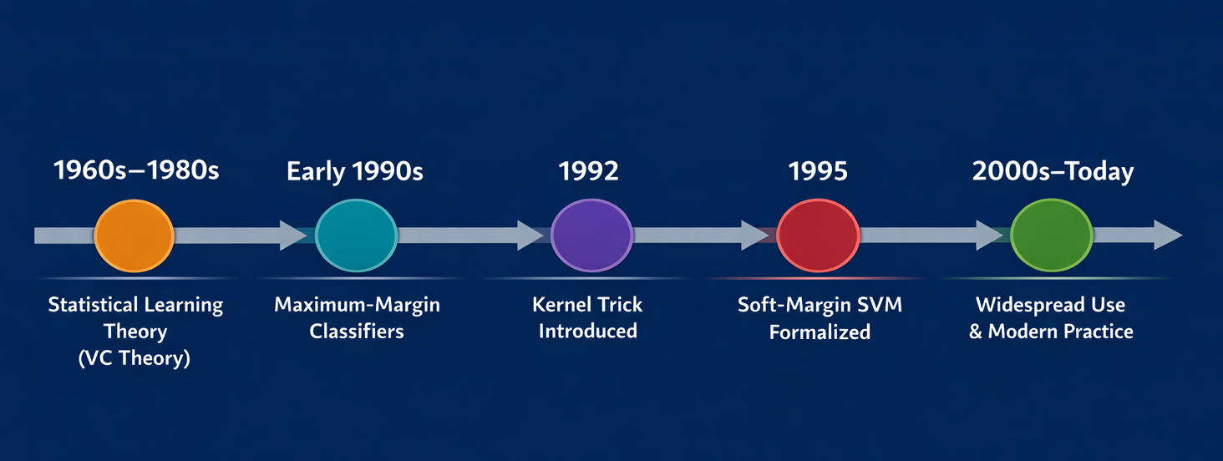
Support Vector Machines
The History and Development
Classification as an Optimization Problem
Vapnik and Chervonenkis
Non-linear decision boundaries

Slide 35
Agenda
What is ML? Why ML?
Categories of ML
Support Vector Machines
Basic idea
Special Cases
History and Development
Math

Slide 36
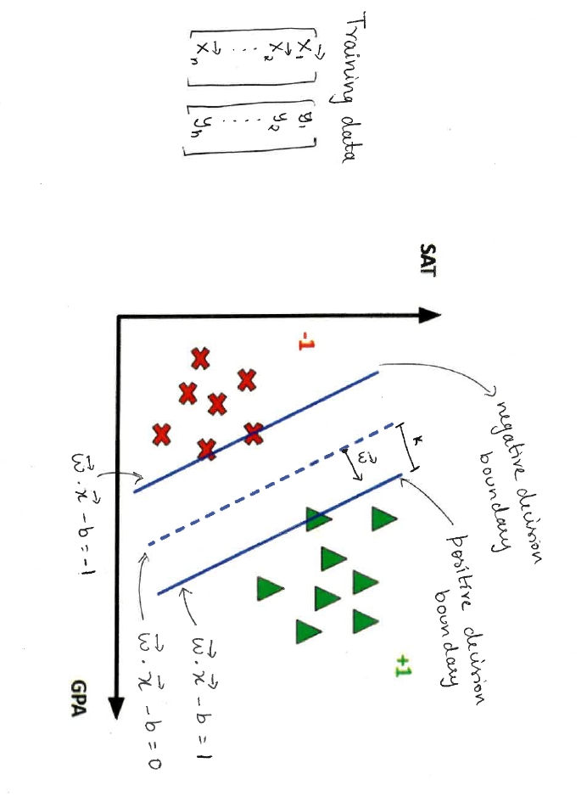
Hard Margin SVM
The Math
Problem Setup: Binary Classification
We want to classify data into two categories. For example, predicting whether a student gets into tech school (y = +1) or does not (y = -1).
The Data:
n total students
For each student i, we have:
A feature vector xᵢ (e.g., GPA, SAT scores, … )
A label yᵢ ∈ {-1, +1}
The Goal: Build an SVM model that creates a maximum margin classifier—a decision boundary with the largest possible "safety zone" between the two classes. This breathing room helps the model generalize better to new, unseen data.

Slide 37
Hard Margin SVM
The Math
To find the best separating boundary, we define three parallel hyperplanes
What is the distance between the two margin boundaries?

Slide 38
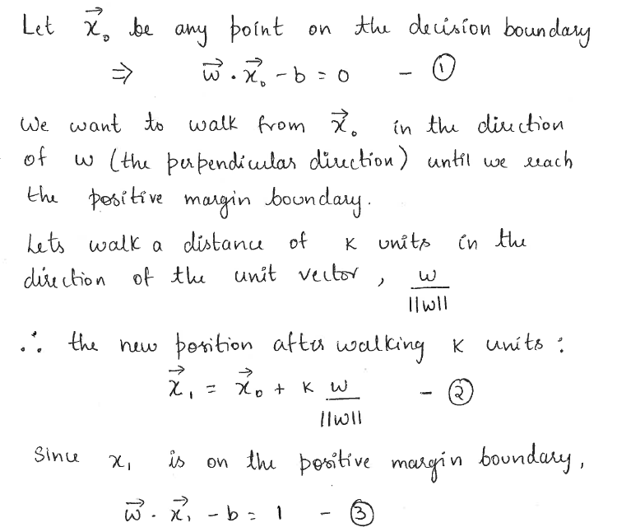
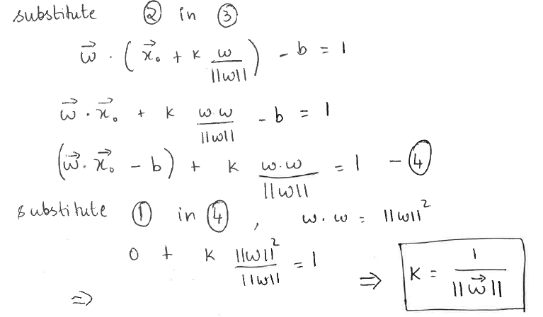
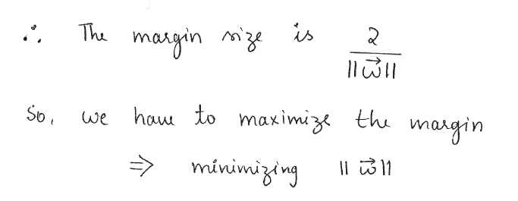
Hard Margin SVM
The Math

Slide 39
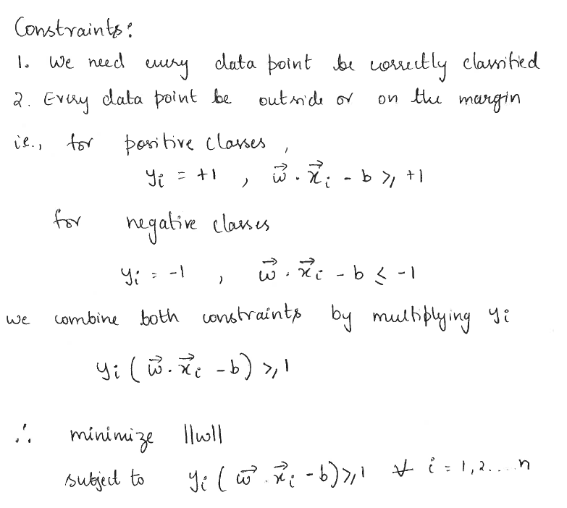
Hard Margin SVM
The Math

Slide 40
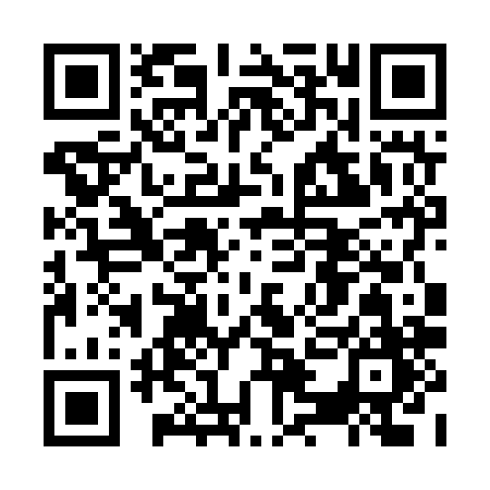
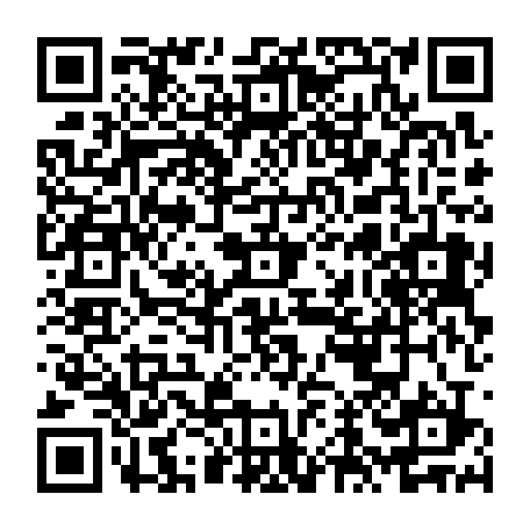



Slide 41
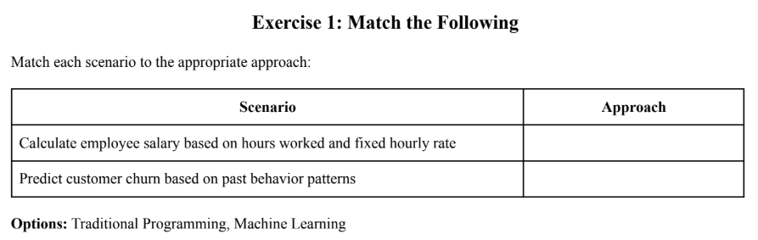

Slide 42
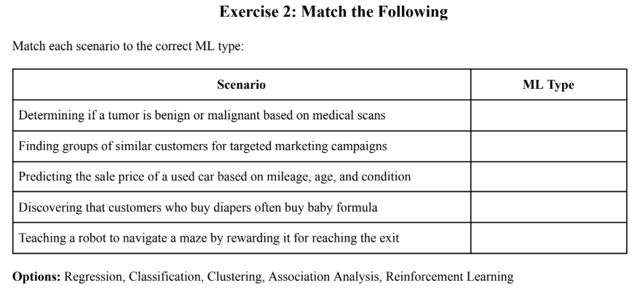

Slide 43
